Slide 1


Slide 2
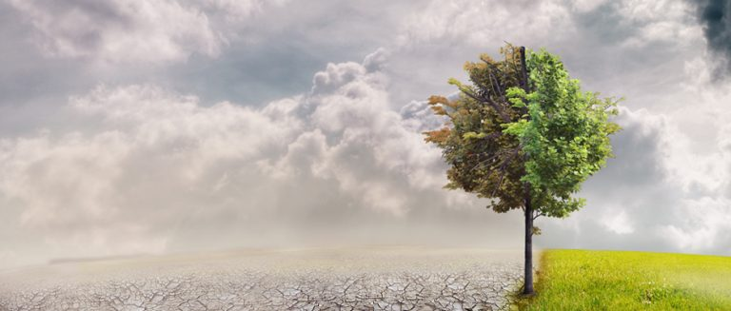
Topic : Climatic Changes & Carbon Footprints
Presented By :
Sarthak Mittal
Sanskriti Sharma
Sumedh Koli
Aaditya Shrivastav

Slide 3
INDEX
Defining Climatic Change
Poster
Defining Climatic Changes
Effects of Climatic Changes
Poster

Slide 4


Slide 5
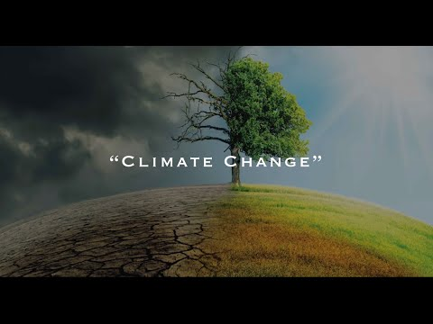

Slide 6
CLIMATIC CHANGES -
Climate change refers to long-term shifts in temperatures and weather patterns. These shifts may be natural, such as through variations in the solar cycle. But since the 1800s, human activities have been the main driver of climate change, primarily due to burning fossil fuels like coal, oil and gas.

Slide 7
Effects of Climatic Change …….

Slide 8
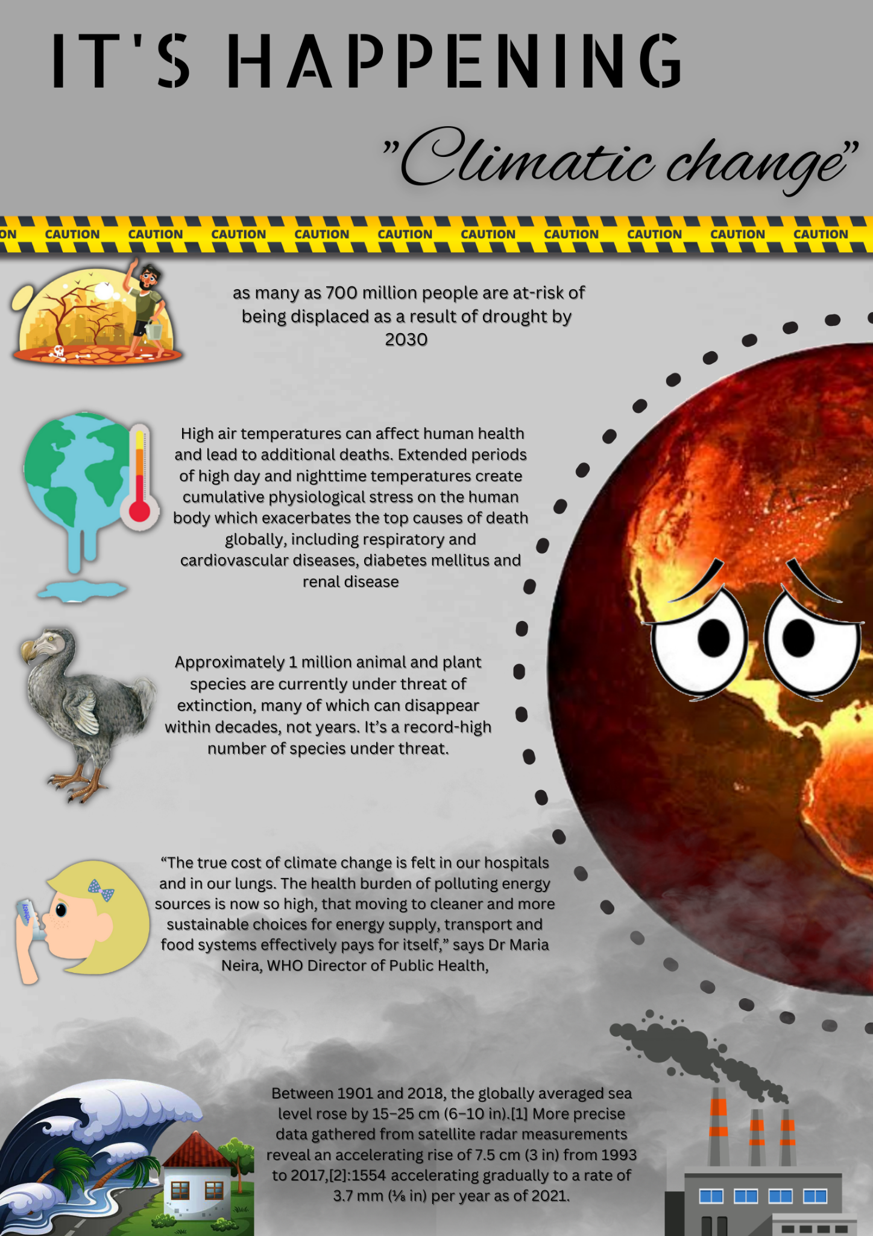

Slide 9
How to Reduce The Effect Of Climatic Change?

Slide 10
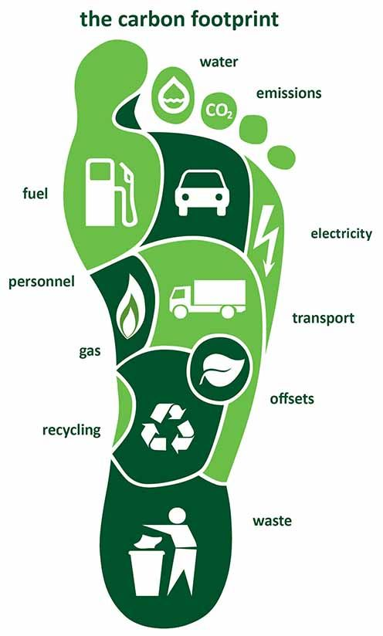
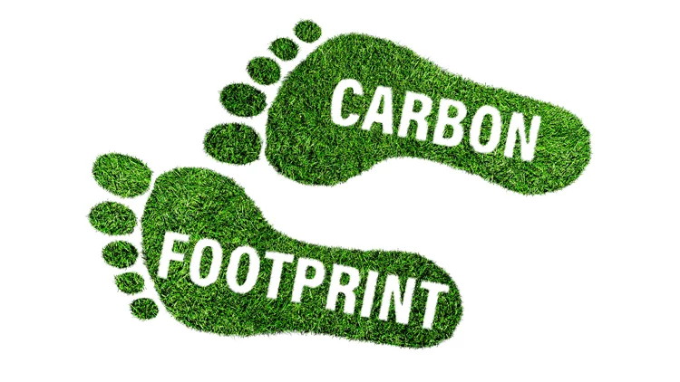
Carbon Footprint
A carbon footprint is the total amount of greenhouse gases (including carbon dioxide and methane) that are generated by our actions.

Slide 11
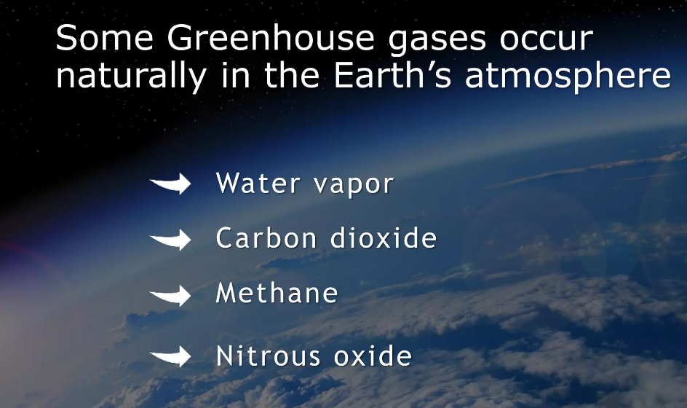

Slide 12
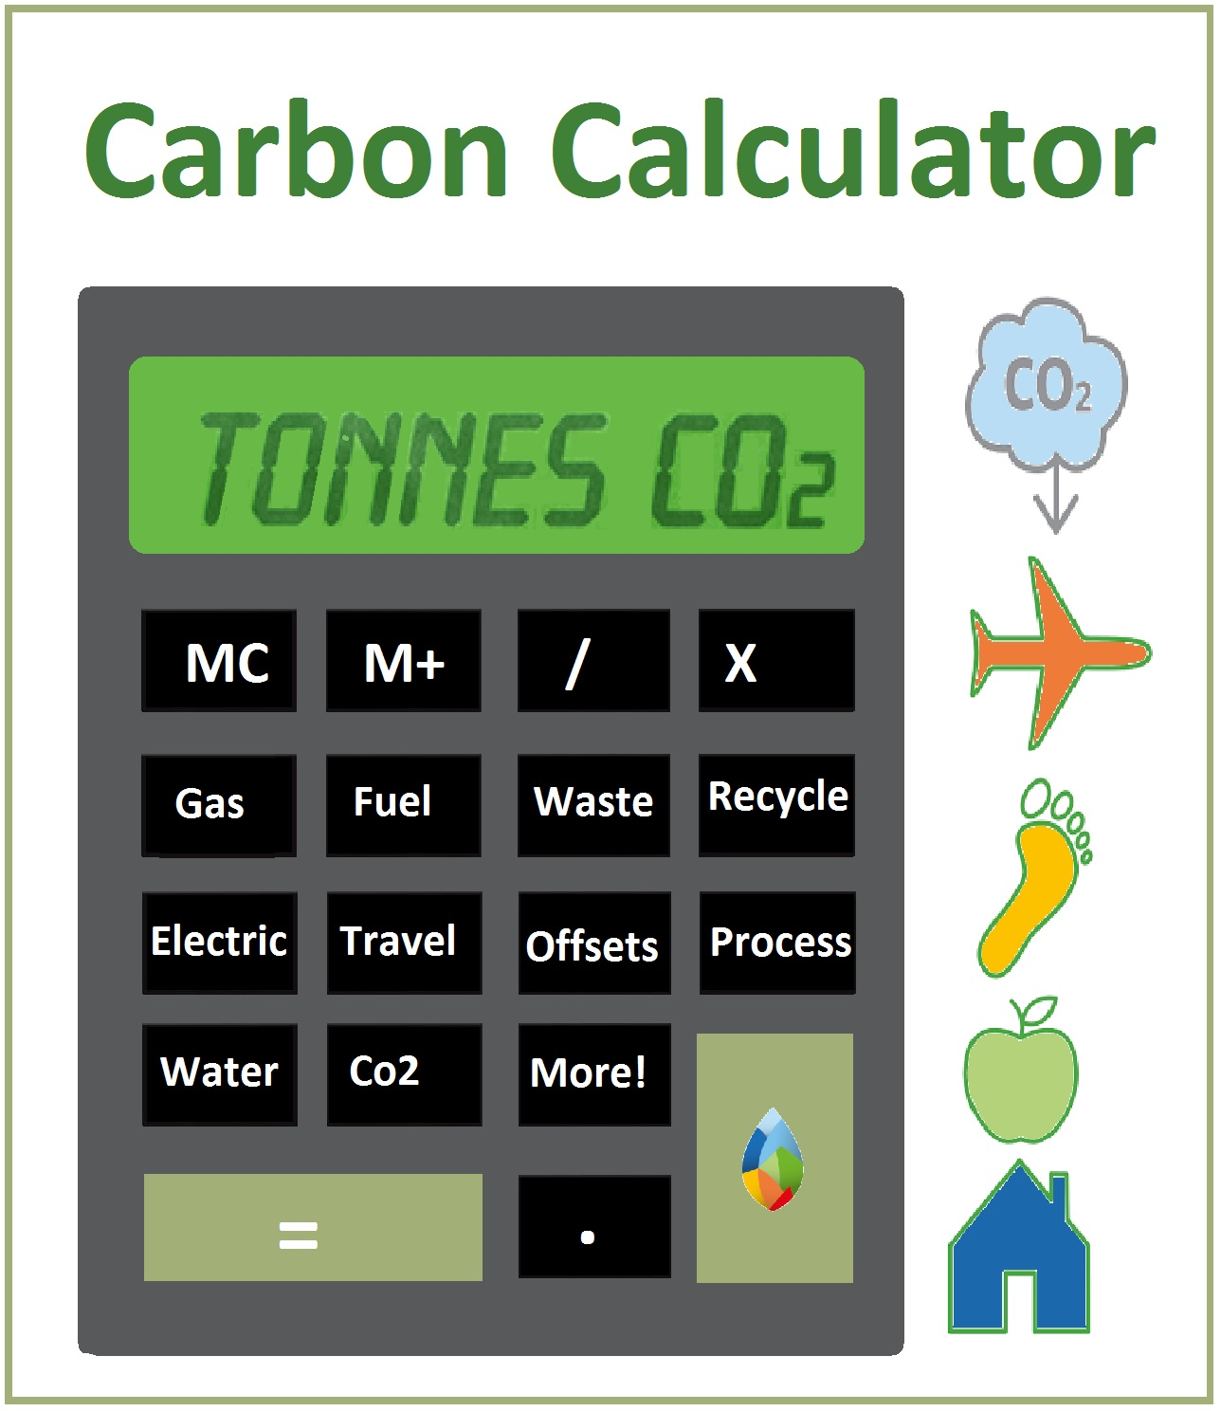
Carbon Footprint Calculation
We all leave a mark on our planet. Think of your carbon footprint as your personal impact.
In technical terms, your carbon footprint is the amount of greenhouse gas you produce in units of carbon dioxide. This footprint is determined by your daily lifestyle and activities, such as travel (car, plane, train, etc), electrical use, consumption of products and services, foods you eat, etc.

Slide 13
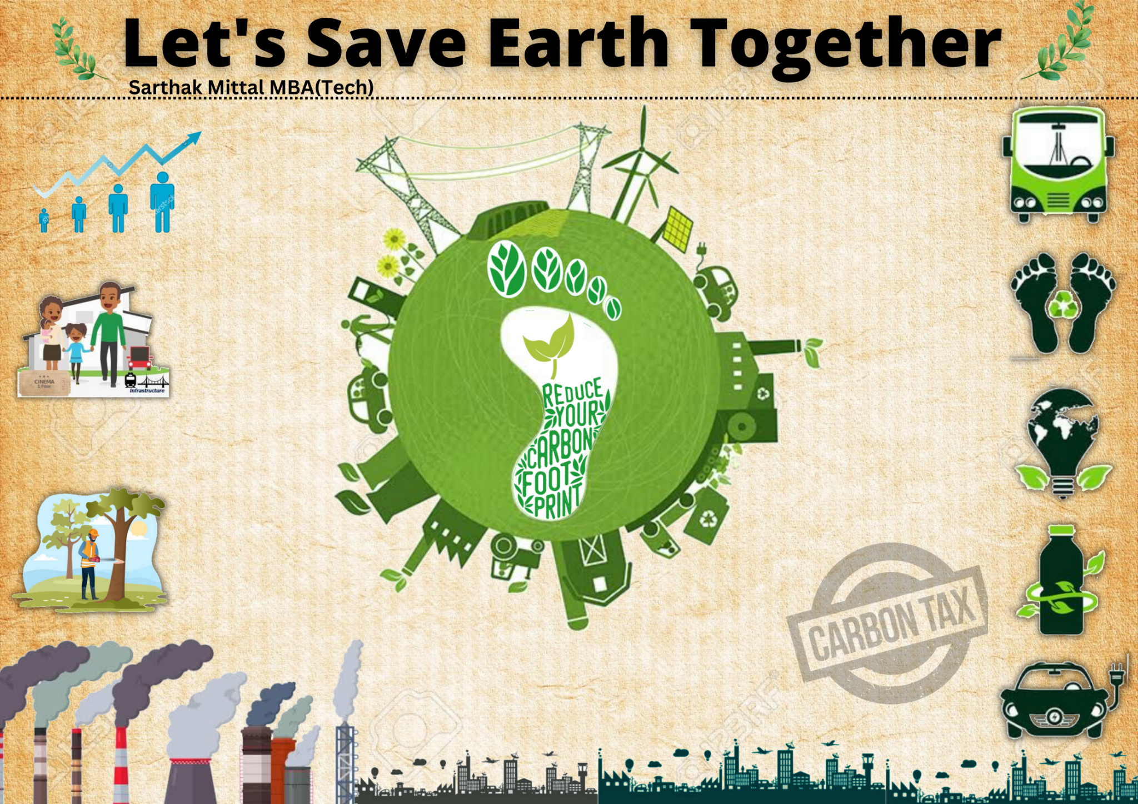

Slide 14
